Slide 1
Linear Classification Introduction to Classification using Linear Classifiers
Last modified 1/1/19

Slide 2
Why Start with Linear Classifiers?
Linear classifiers are the simplest classifiers
Simpler than decision trees
Textbook starts with decision trees
We will use decision trees to introduce some of the more advanced concepts
Learning method is linear regression
We will use linear classifiers to introduce some concepts in classification
Linear classifier also provides yet one more classification algorithm
Also helps demonstrate how different algorithms form different types of decision boundaries

Slide 3
Classification: Definition
Given a collection of records (training set )
Each record contains a set of attributes and a class attribute
Model the class attribute as a function of other attributes
Goal: previously unseen records should be assigned a class as accurately as possible (predictive accuracy)
A test set is used to determine the accuracy of the model
Usually the given labeled data is divided into training and test sets
Training set used to build the model and test set to evaluate it

Slide 4
Illustrating Classification Task

Slide 5

Classification Examples
Predicting tumor cells as benign or malignant
Classifying credit card transactions as legitimate or fraudulent
Classifying physical activities based on smartphone sensor data
Categorizing news stories as finance, weather, entertainment, sports, etc

Slide 6
Classification Techniques
Decision Tree based Methods
Memory based reasoning (Nearest Neighbor)
Neural Networks
Naïve Bayes
Support Vector Machines
Linear Regression (we start with this)

Slide 7
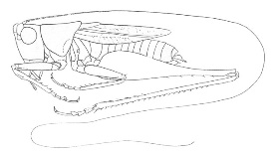
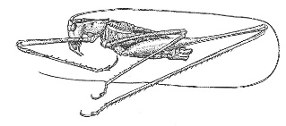
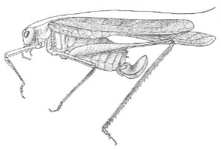
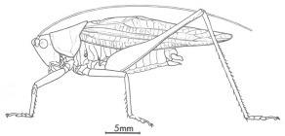
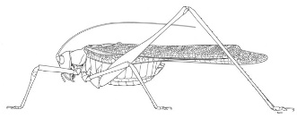
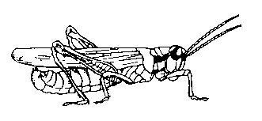
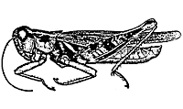
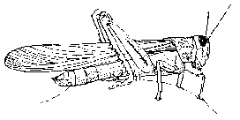
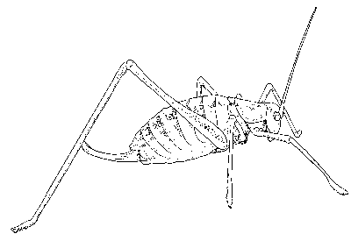
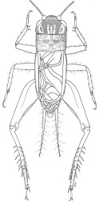
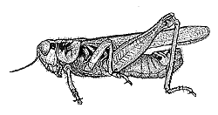
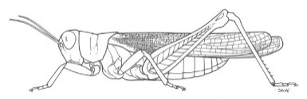
The Classification Problem
Katydids
Given a collection of 5 instances of Katydids and five Grasshoppers, decide what type of insect the unlabeled corresponds to.
Grasshoppers
Katydid or Grasshopper?

Slide 8
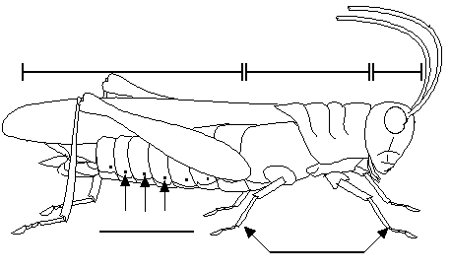
For any domain of interest,
we can measure features
Color {Green, Brown, Gray, Other}
Has Wings?
Abdomen
Length
Thorax Length
Antennae
Length
Mandible
Size
Spiracle
Diameter
Leg Length

Slide 9
We can store features in a database.
My_Collection
Insect ID | Abdomen Length | Antennae Length | Insect Class
1 | 2.7 | 5.5 | Grasshopper
2 | 8.0 | 9.1 | Katydid
3 | 0.9 | 4.7 | Grasshopper
4 | 1.1 | 3.1 | Grasshopper
5 | 5.4 | 8.5 | Katydid
6 | 2.9 | 1.9 | Grasshopper
7 | 6.1 | 6.6 | Katydid
8 | 0.5 | 1.0 | Grasshopper
9 | 8.3 | 6.6 | Katydid
10 | 8.1 | 4.7 | Katydids
The classification problem can now be expressed as:
Given a training database, predict the class label of a previously unseen instance
previously unseen instance =
11 | 5.1 | 7.0 | ???????

Slide 10


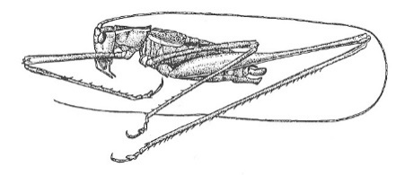
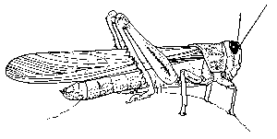

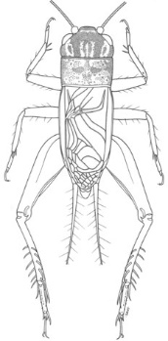
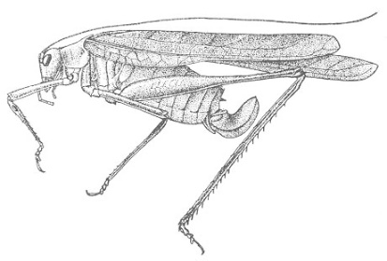


Grasshoppers
Katydids
10
9
8
7
6
Antenna Length
5
4
3
2
1
1
2
3
4
5
6
7
8
9
10
Abdomen Length

Slide 11
Grasshoppers
Katydids
10
9
8
7
6
Antenna Length
5
Each of these data objects are called…
exemplars
(training) examples
instances
tuples
4
3
2
1
1
2
3
4
5
6
7
8
9
10
Abdomen Length

Slide 12

We will return to the previous slide in two minutes. In the meantime, we are going to play a quick game.

Slide 13
Problem 1
Examples of class A
Examples of class B
3 4
5 2.5
1.5 5
5 2
6 8
8 3
2.5 5
4.5 3

Slide 14


Problem 1
What class is this object?
Examples of class A
Examples of class B
3 4
5 2.5
8 1.5
What about this one, A or B?
1.5 5
5 2
6 8
8 3
4.5 7
2.5 5
4.5 3

Slide 15

Problem 2
Oh! This ones hard!
Examples of class A
Examples of class B
4 4
5 2.5
8 1.5
5 5
2 5
6 6
5 3
3 3
2.5 3

Slide 16

Problem 3
Examples of class A
Examples of class B
6 6
4 4
5 6
This one is really hard!
What is this, A or B?
1 5
7 5
6 3
4 8
3 7
7 7

Slide 17


Why did we spend so much time with this game?
Because we wanted to show that almost all classification problems have a geometric interpretation, check out the next 3 slides…

Slide 18

Problem 1
10
9
8
Examples of class A
Examples of class B
7
6
Left Bar
5
4
3
2
3 4
5 2.5
1
1
2
3
4
5
6
7
8
9
10
Right Bar
1.5 5
5 2
Here is the rule again.
If the left bar is smaller than the right bar, it is an A, otherwise it is a B.
6 8
8 3
2.5 5
4.5 3

Slide 19

Problem 2
10
9
8
Examples of class A
Examples of class B
7
6
Left Bar
5
4
3
2
4 4
5 2.5
1
1
2
3
4
5
6
7
8
9
10
Right Bar
5 5
2 5
Let me look it up… here it is.. the rule is, if the two bars are equal sizes, it is an A. Otherwise it is a B.
6 6
5 3
3 3
2.5 3

Slide 20

Problem 3
100
90
80
Examples of class A
Examples of class B
70
60
Left Bar
50
40
30
20
4 4
5 6
10
10
20
30
40
50
60
70
80
90
100
Right Bar
1 5
7 5
6 3
4 8
The rule again:
if the square of the sum of the two bars is less than or equal to 100, it is an A. Otherwise it is a B.
3 7
7 7

Slide 21
Problem 3
An alternative rule that works on the original training data is X + Y ≤ 10 ➔ Class A; else B
Which is better?
Ultimately is one right and one wrong?

Slide 22
Grasshoppers
Katydids
10
9
8
7
6
Antenna Length
5
4
3
2
1
1
2
3
4
5
6
7
8
9
10
Abdomen Length

Slide 23
previously unseen instance =
11 | 5.1 | 7.0 | ???????
We can “project” the previously unseen instance into the same space as the database.
We have now abstracted away the details of our particular problem. It will be much easier to talk about points in space.
10
9
8
7
6
Antenna Length
5
4
3
2
1
Katydids
Grasshoppers
1
2
3
4
5
6
7
8
9
10
Abdomen Length

Slide 24
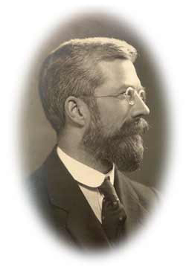
Simple Linear Classifier
10
9
8
7
R.A. Fisher
1890-1962
6
5
If previously unseen instance above the line
then
class is Katydid
else
class is Grasshopper
4
3
2
1
Katydids
Grasshoppers
1
2
3
4
5
6
7
8
9
10

Slide 25
Fitting a Model to Data
One way to build a predictive model is to specify the structure of the model with some parameters missing
Parameter learning or parameter modeling
Common in statistics but includes data mining methods since fields overlap
Linear regression, logistic regression, support vector machines

Slide 26
Linear Discriminant Functions
Equation of a line is y = mx + b
A classification function may look like:
Class + : if 1.0 × age – 1.5 × balance + 60 > 0
Class - : if 1.0 × age – 1.5 × balance + 60 ≤ 0
General form is f(x) = w₀ + w₁x₁ + w₂x₂ + …
Parameterized model where the weights for each feature are the parameters
The larger the magnitude of the weight the more important the feature
The separator is a line when 2D, plane with 3D, and hyperplane with more than 3D

Slide 27
What is the Best Separator?
Each separator has a different margin, which is the distance to the closest point. The orange line has the largest margin.
For support vector machines, the line/plane with the largest margin is best.
10
9
8
7
6
5
4
3
2
1
1
2
3
4
5
6
7
8
9
10

Slide 28
Scoring and Ranking Instances
Sometimes we want to know which examples are most likely to belong to a class
Linear discriminant functions can give us this
Closer to separator is less confident and further away is more confident
In fact the magnitude of f(x) give us this where larger values are more confident/likely

Slide 29
Class Probability Estimation
Class probability estimation is also something you often want
Often free with methods like decision trees
More complicated with linear discriminant functions since the distance from the separator not a probability
Logistic regression solves this
We will not go into the details in this class
Logistic regression determines class probability estimate

Slide 30
Classification Accuracy
 |  | Predicted class
 |  | Class = Katydid (1) | Class = Grasshopper (0)
Actual Class | Class = Katydid (1) | f₁₁ | f₁₀
 | Class = Grasshopper (0) | f₀₁ | f₀₀
Confusion Matrix
Number of correct predictions f₁₁ + f₀₀
Accuracy = --------------------------------------------- = -----------------------
Total number of predictions f₁₁ + f₁₀ + f₀₁ + f₀₀
Number of wrong predictions f₁₀ + f₀₁
Error rate = --------------------------------------------- = -----------------------
Total number of predictions f₁₁ + f₁₀ + f₀₁ + f₀₀

Slide 31
Confusion Matrix
In a binary decision problem, a classifier labels examples as either positive or negative.
Classifiers produce confusion/ contingency matrix, which shows four entities: TP (true positive), TN (true negative), FP (false positive), FN (false negative)
Confusion Matrix
 | Predicted Positive (+) | Predicted Negative (-)
Actual Positive (Y) | TP | FN
Actual Negative (N) | FP | TN
For now responsible for knowing Recall and Precision

Slide 32
The simple linear classifier is defined for higher dimensional spaces…

Slide 33
… we can visualize it as being an n-dimensional hyperplane

Slide 34
Which of the “Problems” can be solved by the Simple Linear Classifier?
10
9
8
7
6
Perfect
Useless
Pretty Good
5
4
3
2
1
1
2
3
4
5
6
7
8
9
10
100
10
90
9
Problems that can be solved by a linear classifier are call linearly separable.
80
8
70
7
60
6
50
5
40
4
30
3
20
2
10
1
10
20
30
40
50
60
70
80
90
100
1
2
3
4
5
6
7
8
9
10

Slide 35
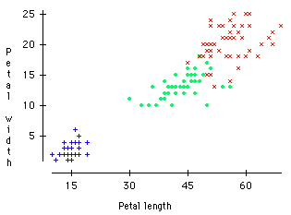
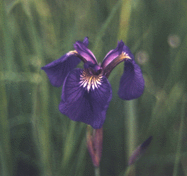

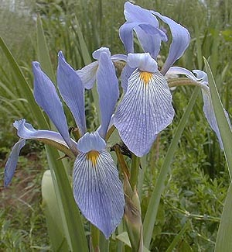
A Famous Problem
R. A. Fisher’s Iris Dataset.
3 classes
50 of each class
The task is to classify Iris plants into one of 3 varieties using Petal Length and Petal Width.
Data: https://archive.ics.uci.edu/ml/datasets/iris
Virginica
Versicolor
Setosa
Setosa
Versicolor
Iris Setosa
Iris Versicolor
Iris Virginica

Slide 36
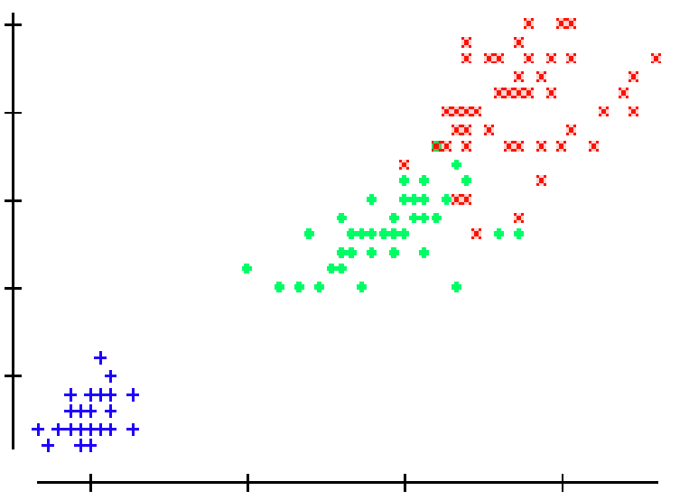
We can generalize to N classes by fitting N-1 lines. In this case we first learn the line to discriminate between Setosa and Virginica/Versicolor, then we learned to approximately discriminate between Virginica and Versicolor.
Virginica
Setosa
Versicolor
If petal width > 3.272 – (0.325 * petal length) then class = Virginica
Elseif petal width…

Slide 37
How to Compare Classification Algorithms?
What criteria do we care about? What matters?
Performance- predictive accuracy etc.
Speed and Scalability
time to construct model
time to use/apply the model
Expressive Power
how flexible is the decision boundary
Interpretability
understanding and insight provided by the model
ability to explain/justify the results
Robustness
handling noise, missing values and irrelevant features, streaming data

